Slide 1
History Heroes
Term 2, Week 1

Slide 2
Question 1 (3 marks)
On what date was Herbert Hoover inaugurated as President (day, month, year)?

Slide 3
Question 2 (2 marks)
What date was the Wall Street Crash (month and year)?

Slide 4
Question 3 (1 mark)
State the full name of one of Roosevelt’s Alphabet Agencies.

Slide 5
Question 4 (3 marks)
On what date did the Second World War begin in Europe (day, month, year)?

Slide 6
Question 5 (1 mark)
What event triggered the beginning of WW2?

Slide 7
Question 6 (3 marks)
On what date did America enter WW2 (day, month, year)?

Slide 8
Question 7 (1 mark)
What event triggered Roosevelt to enter America into WW2?

Slide 9
ANSWERS

Slide 10
Question 1 (3 marks)
On what date was Herbert Hoover inaugurated as President (day, month, year)?
4TH March 1929

Slide 11
Question 2 (2 marks)
What date was the Wall Street Crash (month and year)?
October 1929

Slide 12
Question 3 (1 mark)
Agricultural Adjustment Administration
Civilian Conservation Corps
Civil Works Administration
Drought Relief Service
Subsistence Homesteads Division
Emergency Banking Act
Federal Aviation Administration
Federal Art Project
Farm Credit Administration
Federal Communications Commission
Federal Deposit Insurance Corporation
Federal Emergency Relief Administration
Federal Housing Administration
Fair Labor Standards Act
Federal Music Project (part of WPA)
Farm Security Administration
Federal Surplus Relief Corporation
Federal Theatre Project (part of WPA)
Federal Works Agency
Federal Writers' Project (part of WPA)
Home Owners' Loan Corporation
National Industrial Recovery Act
National Labor Relations Act
National Labor Relations Board/The Wagner Act
National Recovery Administration
National Youth Administration
Puerto Rico Reconstruction Administration
Public Works Administration
Resettlement Administration
Rural Electrification Administration (now Rural Utilities Service)
Securities and Exchange Commission
Social Security Administration
Social Security Board (now Social Security Administration)
Tennessee Valley Authority
United States Housing Authority
United States Maritime Commission
Works Progress Administration

Slide 13
Question 4 (3 marks)
On what date did the Second World War begin in Europe (day, month, year)?
September 1st 1939

Slide 14
Question 5 (1 mark)
What event triggered the beginning of WW2?
The invasion of Poland by Germany

Slide 15
Question 6 (3 marks)
On what date did America enter WW2 (day, month, year)?
December 7, 1941

Slide 16
Question 7 (1 mark)
What event triggered Roosevelt to enter America into WW2?
The bombing of Pearl Harbour (American naval base) by the Japanese.

Slide 17
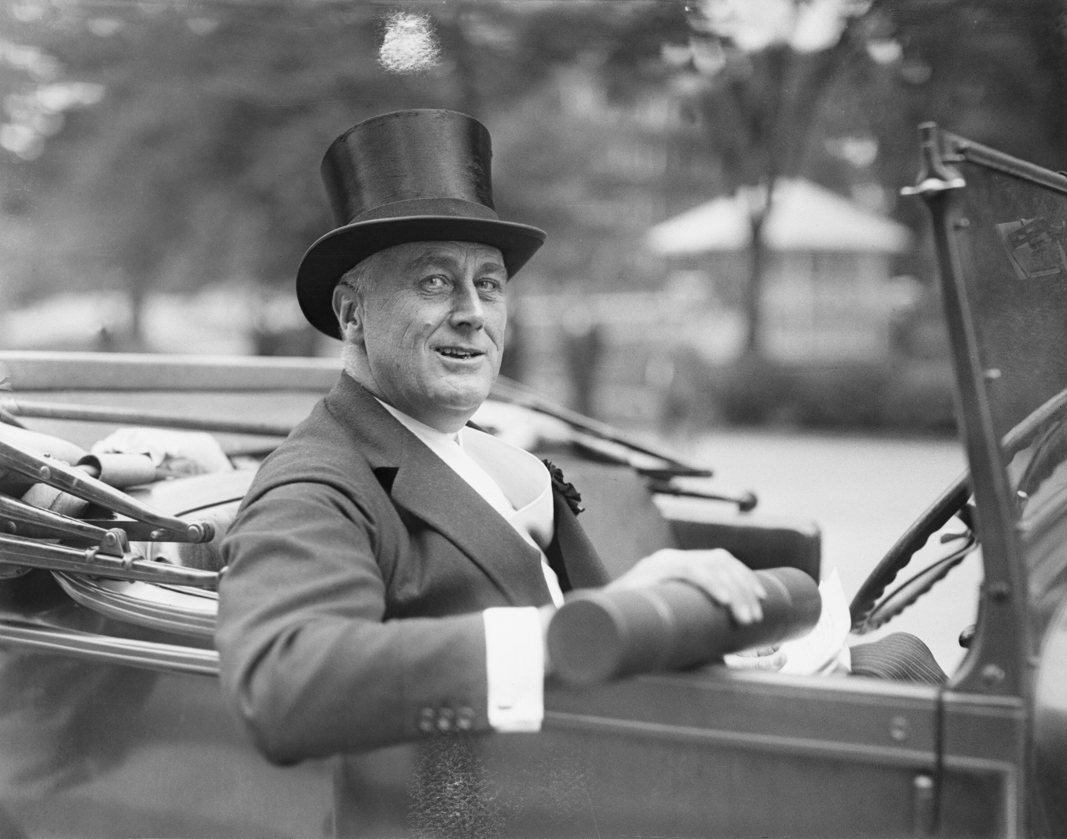
RESULTS??

Slide 18
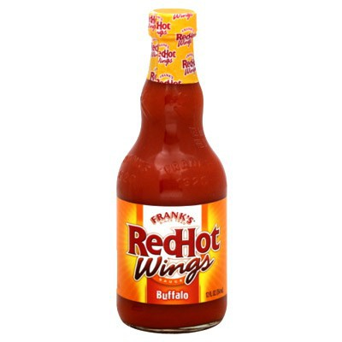
Source of the week

Slide 19
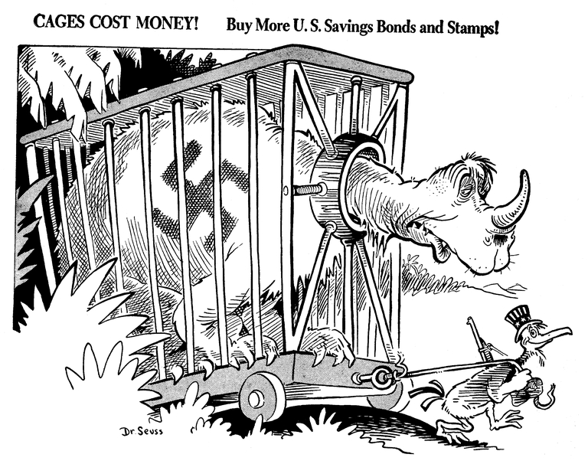
Title: Cages cost money! Creator: Seuss, Dr. Publisher: PM Magazine Date: December 15, 1941
Instead of making notes about the source, list as many questions you have about the source.

